Slide 1
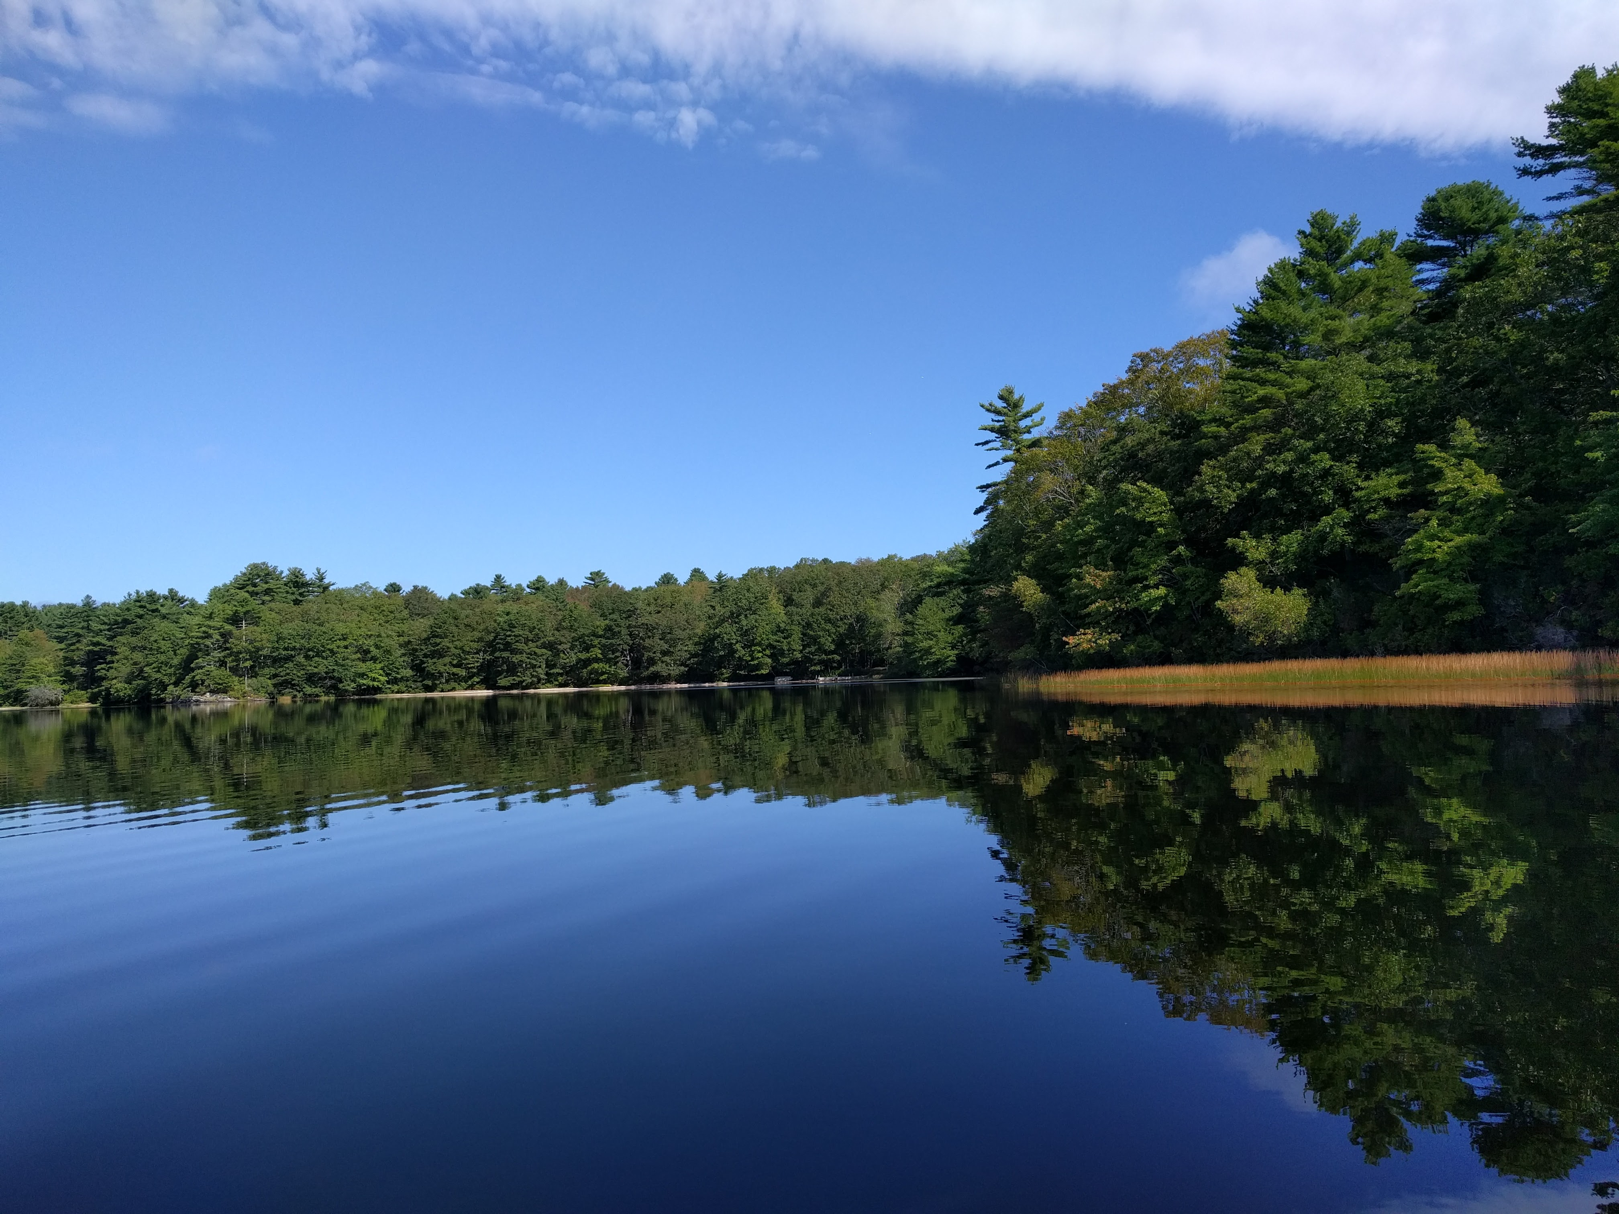
Temporal Dynamics of Cyanobacteria Blooms in Three Rhode Island Ponds
Stephen D. Shivers¹, Betty J. Kreakie¹, Jeffrey W. Hollister¹,Sophie Fournier², and W. Bryan Milstead³
¹EPA Atlantic Coastal Environmental Sciences Division
²ORISE EPA Atlantic Coastal Environmental Sciences Division
³EPA Atlantic Coastal Environmental Sciences Division (emeritus)
12th National Monitoring Conference April 22, 2021

Slide 2
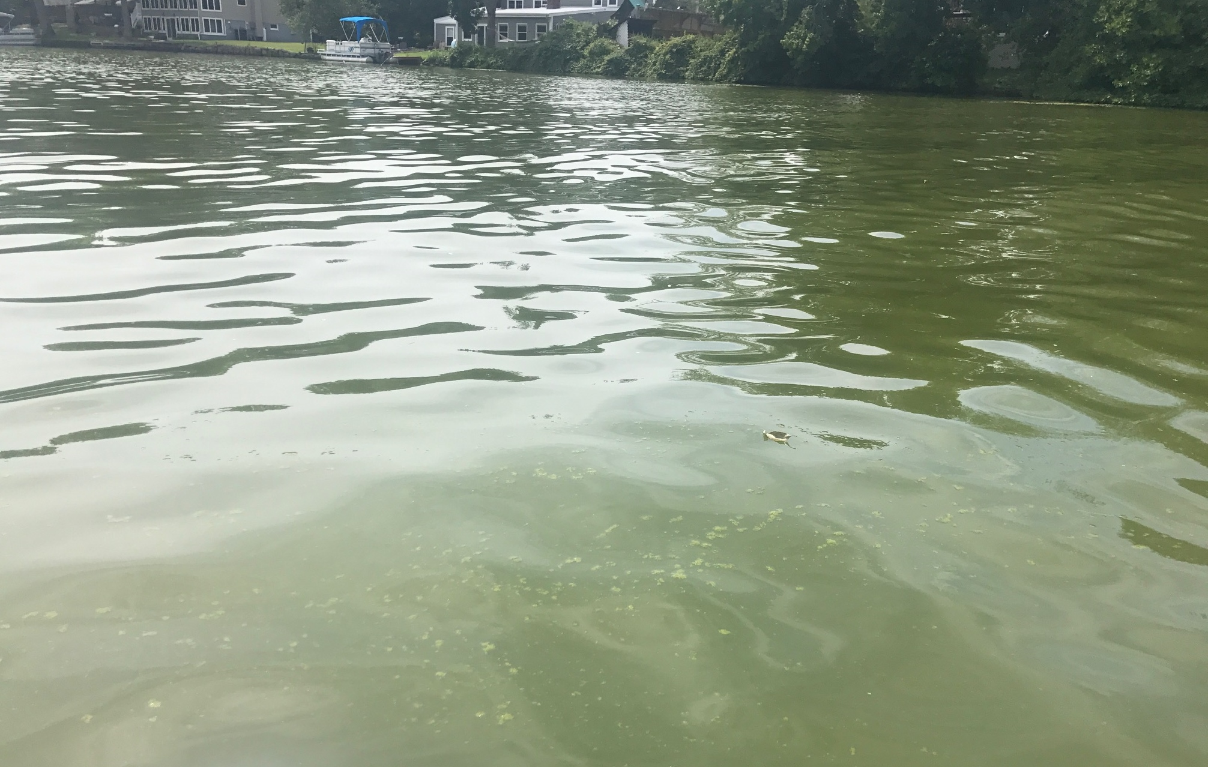
Overview
Introduction
Project goals
Study ponds/methods
Results from 2018-2019
Preliminary conclusions

Slide 3
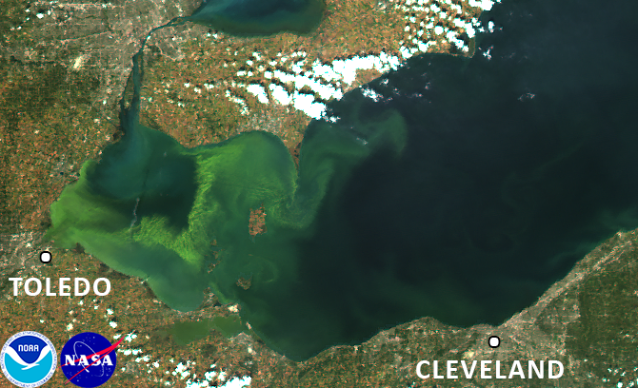
Cyanobacteria and cHABs
Can form dense blooms when conditions (e.g. high nutrients) are appropriate
Certain species produce toxins
Depletes O₂ upon collapse
Bloom frequency/severity increasing
Consequences of HABs can be costly
Image Credit: NASA

Slide 4
Project Goals
How do cyanobacteria blooms change over time and across a lake?
How does the production of cyanotoxins change over space and time?
What is driving the changes in cyanobacteria?
Temperature?
Nutrients?
Ecological communities?

Slide 5
Study Ponds
Mashapaug Pond
Warwick Pond
Yawgoo Pond
EPA

Slide 6
Study Ponds
Mashapaug Pond
Warwick Pond

Slide 7
Study Ponds
Yawgoo Pond

Slide 8
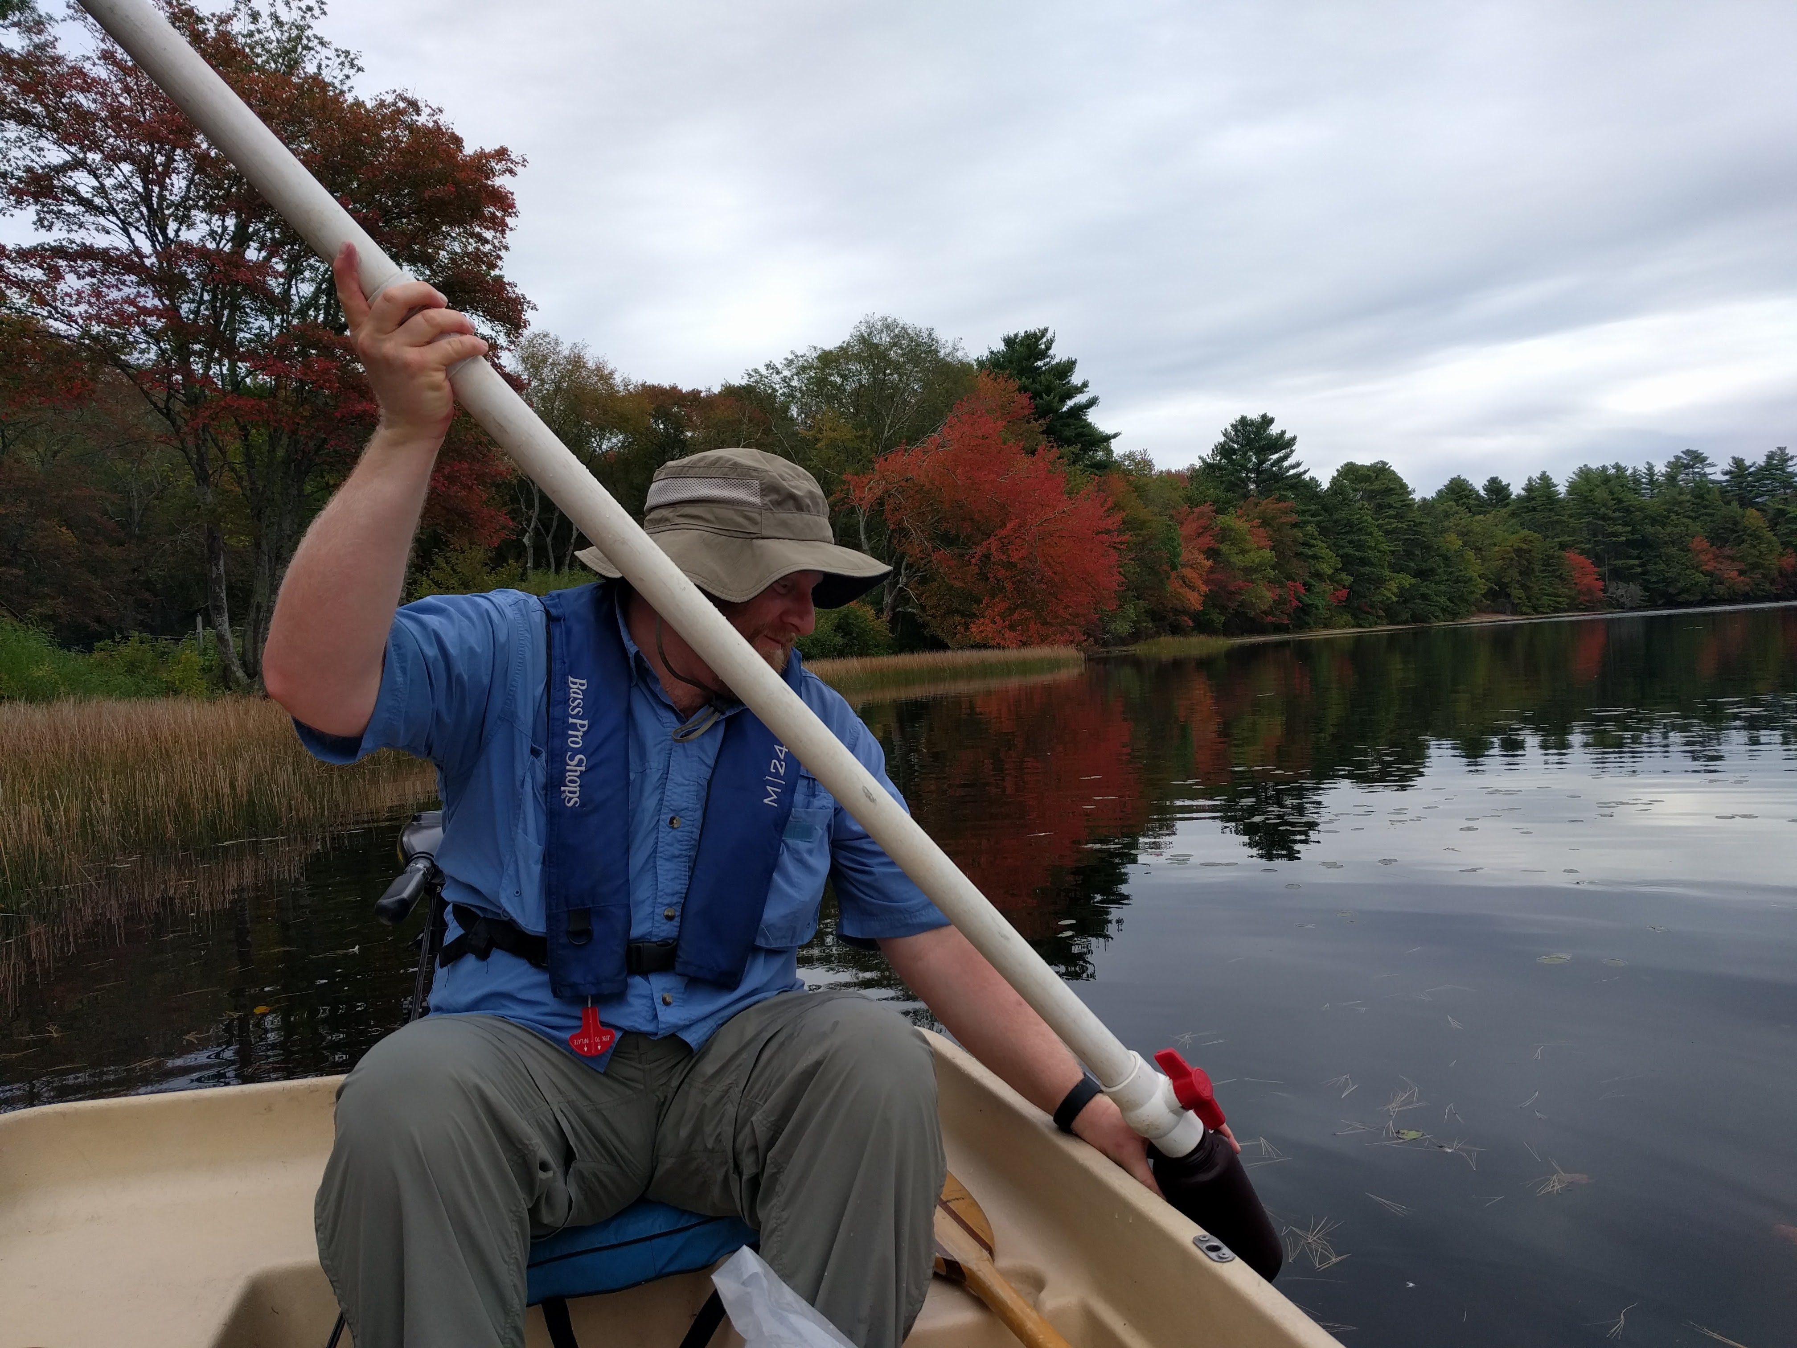
Methods – Littoral Sites
temperature
Physical parameters (temperature, DO, pH, conductivity) measured with a YSI sonde at 0, 1, and 2 m
Secchi depth
2 m integrated water samples collected
Water samples analyzed for chlorophyll a, phycocyanin, turbidity, and microcystin
chlorophyll a
phycocyanin
turbidity

Slide 9
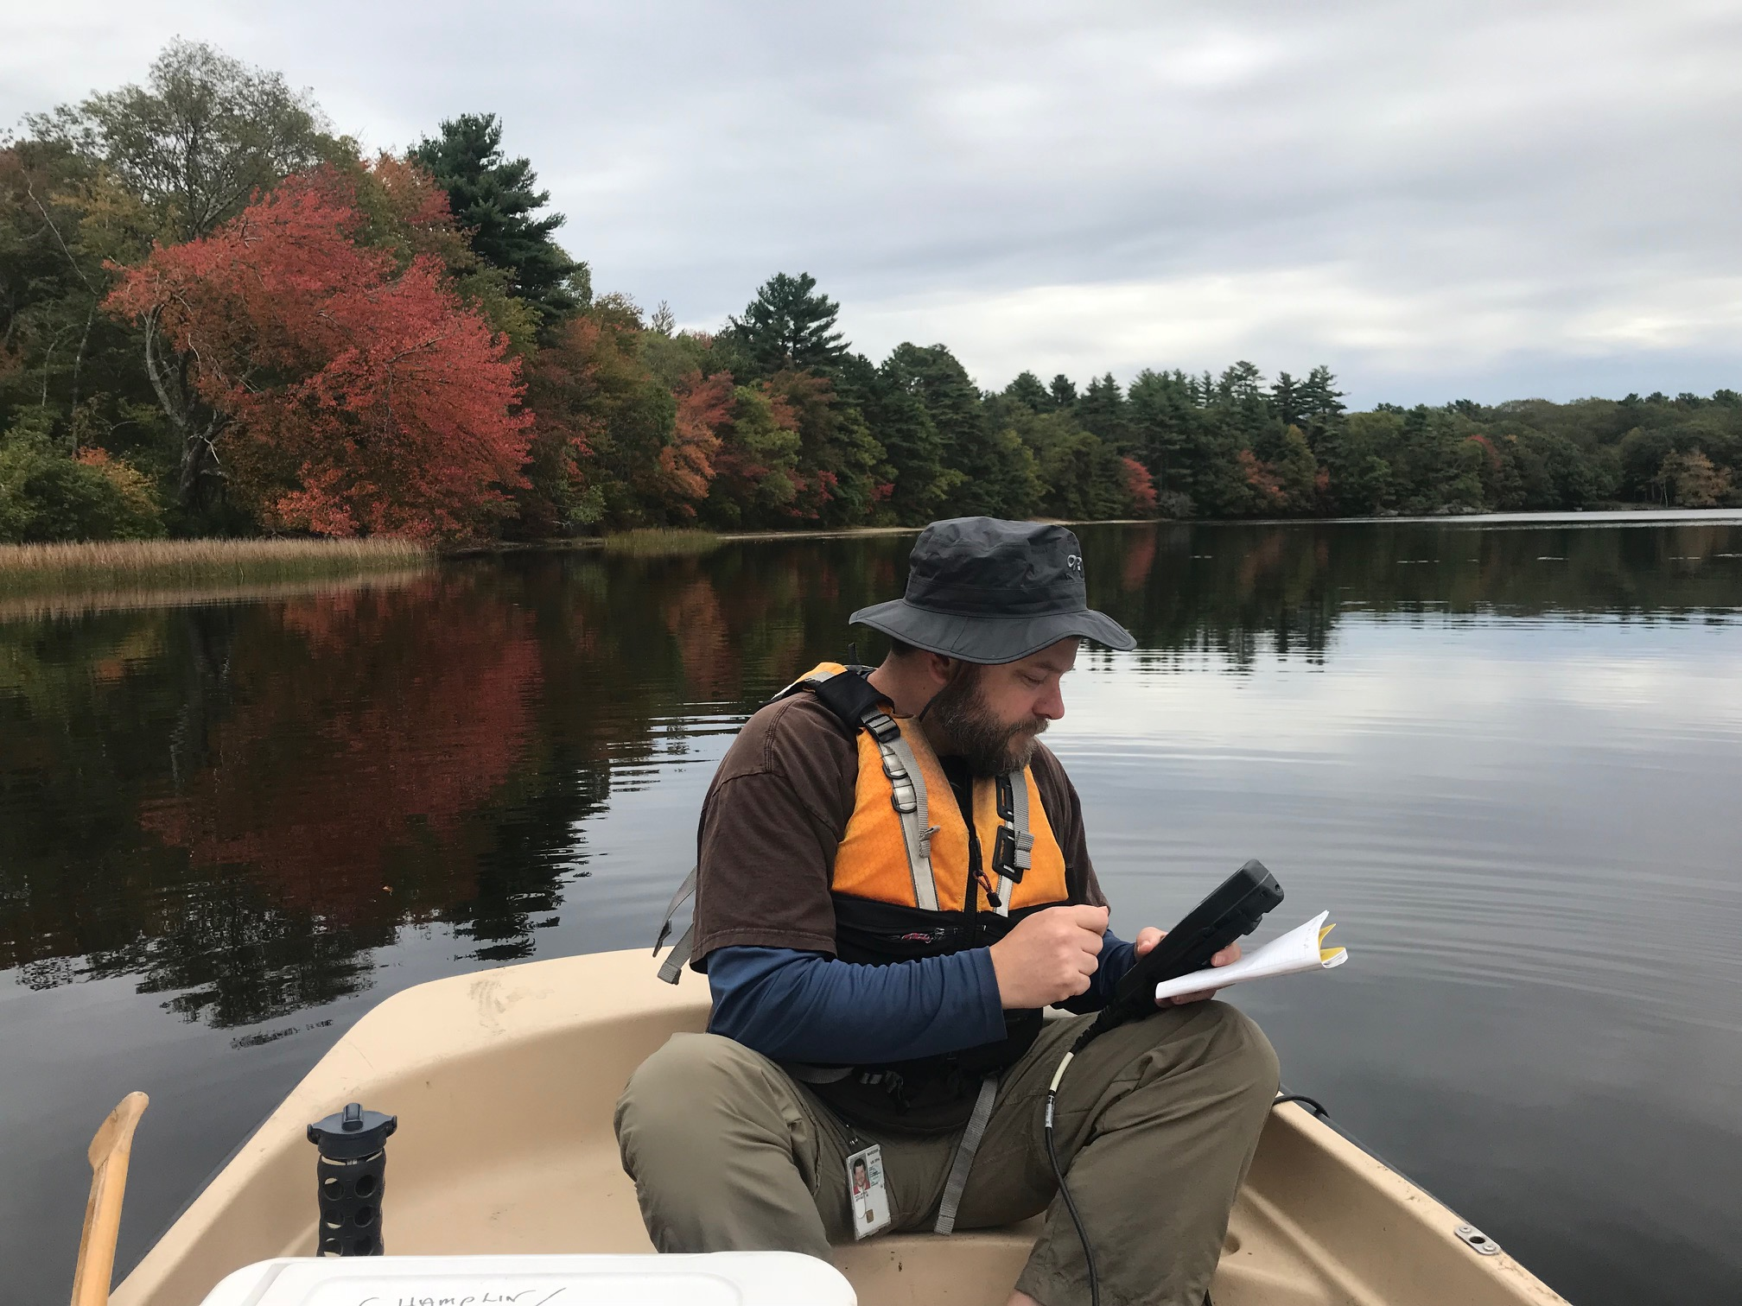
Methods – Deep Sites
Depth profile of physical parameters (1 m increments)
Secchi depth
2 m integrated water samples collected
Water samples analyzed for chlorophyll a, phycocyanin, turbidity, microcystin, and nutrients (NO₃, PO₄, NH₄, TN, and TP)
5 m zooplankton tows (50 um and 150 um mesh)

Slide 10
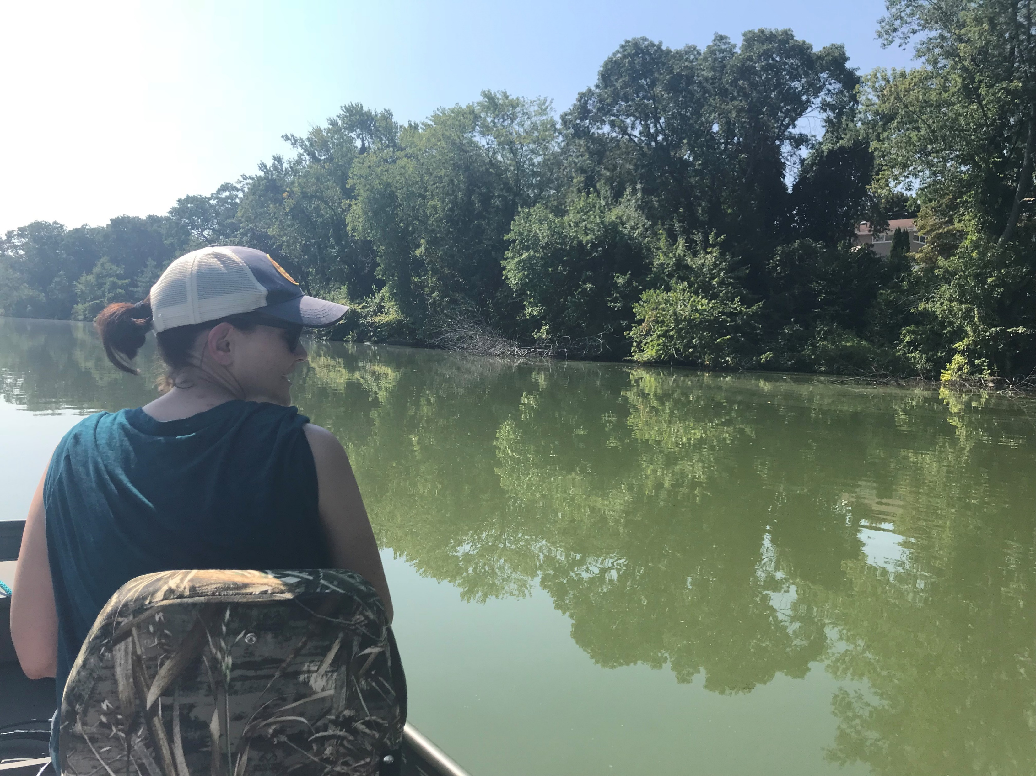
Methods – Frequency
Weekly or 2X weekly
June - November
~35 sampling trips per pond

Slide 11
Results – Chlorophyll a

Slide 12
Results – Phycocyanin

Slide 13
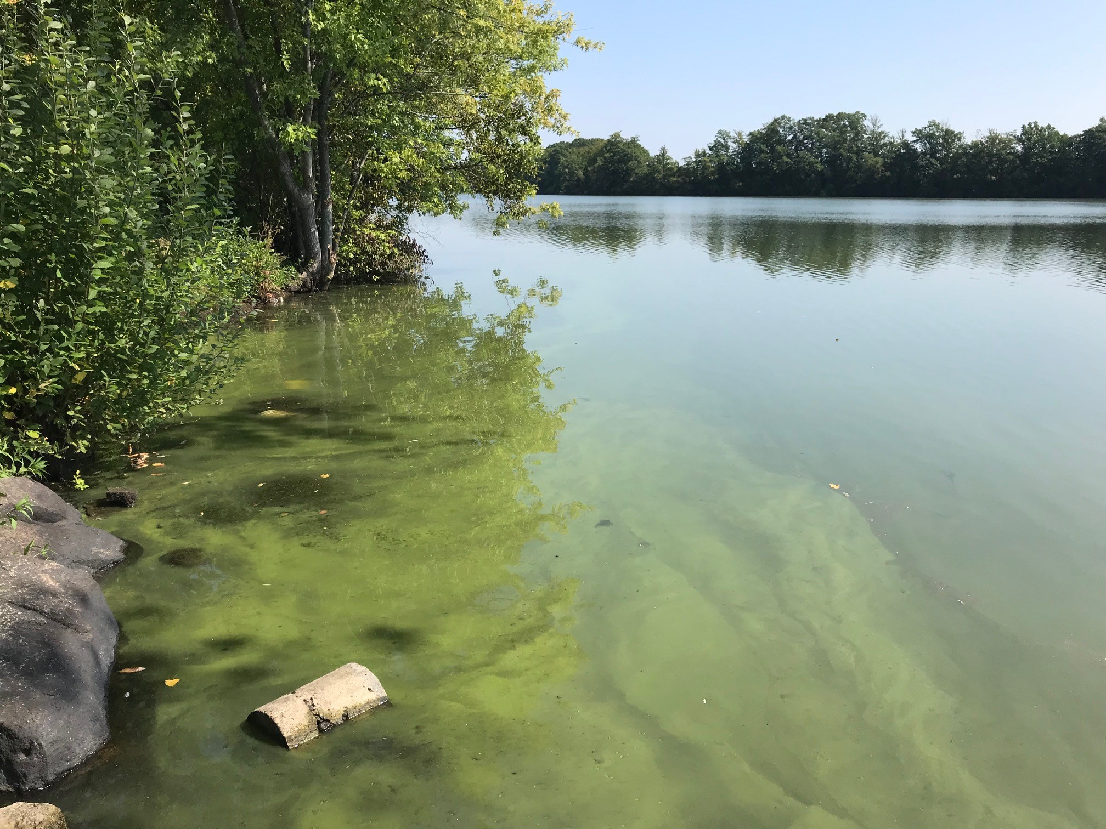
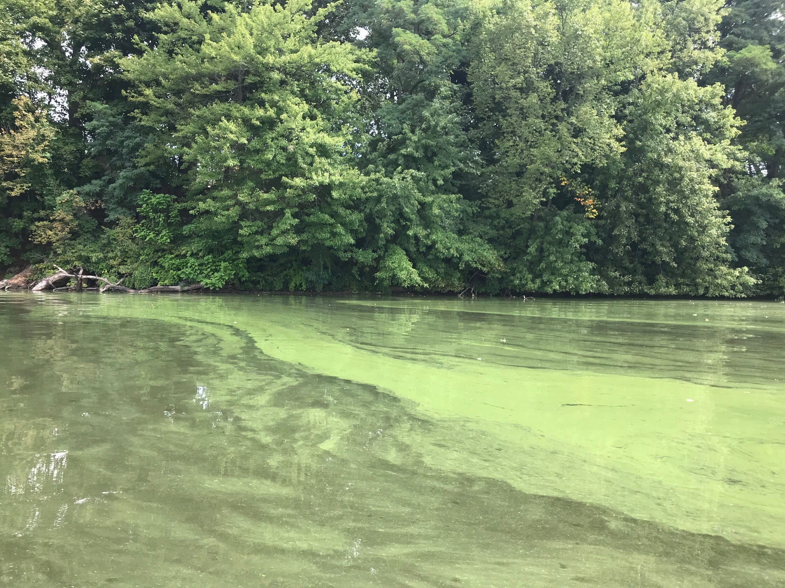
Water Clarity – Mashapaug
2018
2019

Slide 14
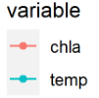
Results – Chl a and Temperature z-scores

Slide 15
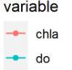
Results – Chl a and Dissolved O₂ z-scores

Slide 16
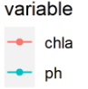
Results – Chl a and pH z-scores

Slide 17
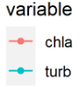
Results – Chl a and Turbidity z-scores

Slide 18
Preliminary Conclusions
There were interannual differences in blooms in both Mashapaug and Warwick ponds
Bloom indicators can change on a short time scale, possibly driven by temperature
More frequent sampling needed!

